Slide 1
Java EE Mini Project
BOOK // Library
Pierre ANKEN & Olivier GOTTET - Classe 606_3
Professor Adrien DEPEURSINGE
Notes:
1
1
1
1

Slide 2
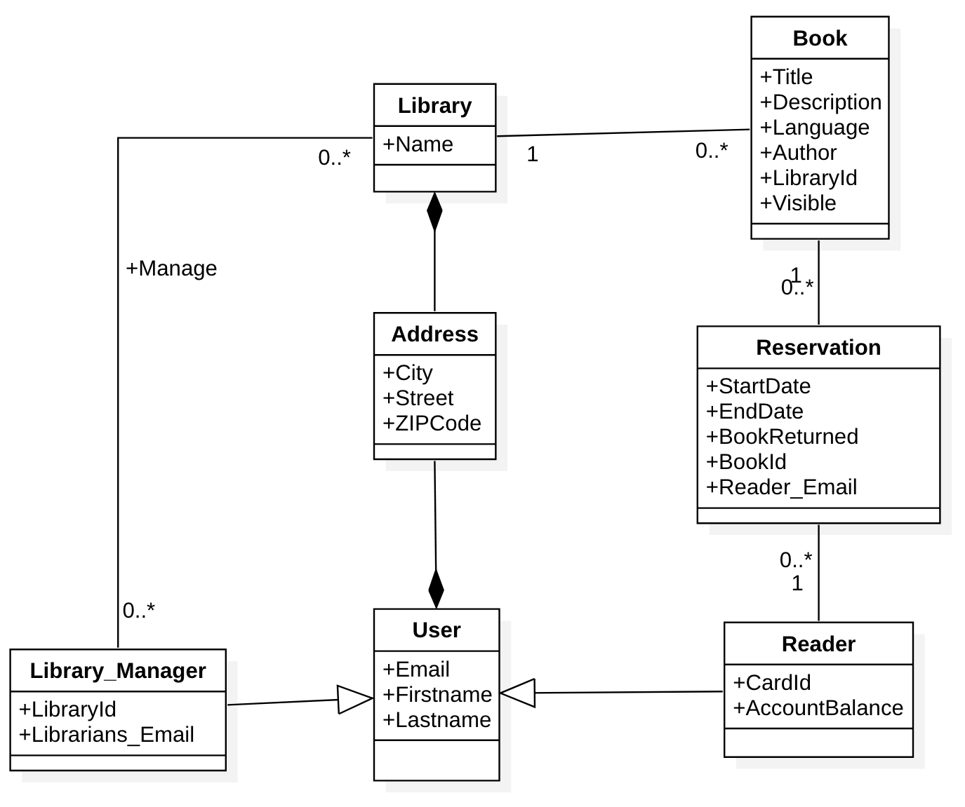
General UML

Slide 3
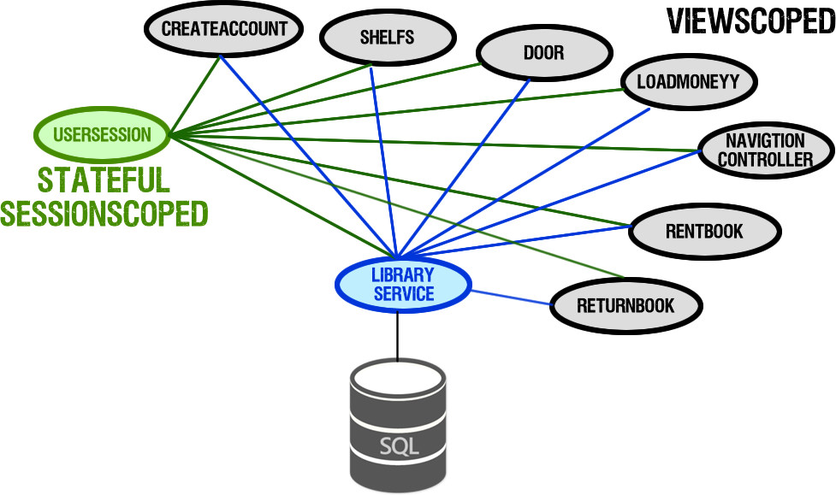
Bean Schema

Slide 4
User Stories
Borrow Books
As a reader I would like to borrow books from the library in order to read my favorite books.
Add, edit and remove books
As a librarian I want to be able to add. edit and remove books from the libraries I am assigned to in order to update my library.
Load money on my account
As a reader i want to be able to load money on my account to be able to borrow new books
Return a book
As a reader I want to be able to return a book in order to make it available for others customers.
Create account
As a user I want to be able to create a reader account in order to be able to borrow books.

Slide 5
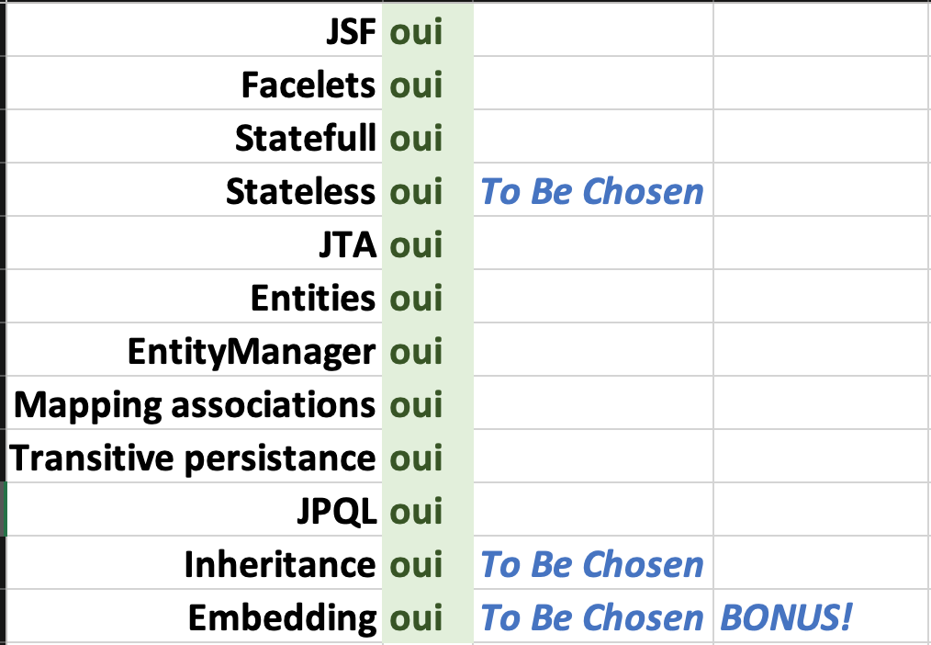
Technology

Slide 6
Highlights
Creative approach
Responsive
AJAX
Stateful & Stateless
Inheritance & Embedding
Managed Properties
JTA
Transitive Persistence
JPQL
Object Mapping as Workaround to make inheritance work (Objects are converted to maps // key & value pairs)

